Slide 1
IBM cloud container services
Notes:
1

Slide 2






Kubernetes Capabilities:
Intelligent Scheduling
Self-healing
Horizontal scaling
Service discovery & load balancing
Automated rollouts and rollbacks
Secret and configuration management

Slide 3






Cluster management capabilities
Simplified Cluster Management
Container Security & Isolation
Design Your Own Cluster
Leverages IBM Cloud & Watson
Native Kubernetes Experience
Integrated Operational Tools

Slide 4
Simplified Cluster Management
Intuitive graphical user experience
CLI and API alternatives
Fully managed master nodes
User controlled worker node management
Container Security & Isolation
Provides Docker image and running application scanning to detect vulnerabilities with Vulnerability Advisor.
Store your images securely in your hosted private registry
Automatic encryption of secrets and volumes
Isolated networking and storage

Slide 5
Design Your Own Cluster
Tunable capacity
Select between shared and dedicated compute
Configurable networking and storage
Leverage IBM Cloud Services
Enhance your application with Watson, IoT, Analytics and Data Services
Persistent Volumes using IBM Cloud storage
IP and application Load Balancing
Integrated with IBM Cloud access management

Slide 6
Native Kubernetes Experience
Seamless experience moving from local development to IBM Bluemix
100% Kubernetes API and tools
Supports Kubernetes dashboard
Leverage Docker images
Integrated Operational Tools
Built-in log and metrics collection with IBM Bluemix log and metrics services
Use with IBM DevOps tools such as Delivery Pipeline
Supports popular add-ons including Prometheus, Weave, sysdig, fluentd and others

Slide 7
IBM cloud container services details
Notes:
7

Slide 8
IBM Cloud and Container Services availability:
IBM Cloud Public console https://console.bluemix.net
IBM Cloud region
IBM Cloud Container Service region

Slide 9
Locations available for the IBM container service
IBM container service API commands
GET https://us-south.containers.bluemix.net/v1/clusters
AP South: https://ap-south.containers.bluemix.net/swagger-api/
EU Central: https://eu-central.containers.bluemix.net/swagger-api/
UK South: https://uk-south.containers.bluemix.net/swagger-api/
US East: https://us-east.containers.bluemix.net/swagger-api/
US South: https://us-south.containers.bluemix.net/swagger-api/

Slide 11
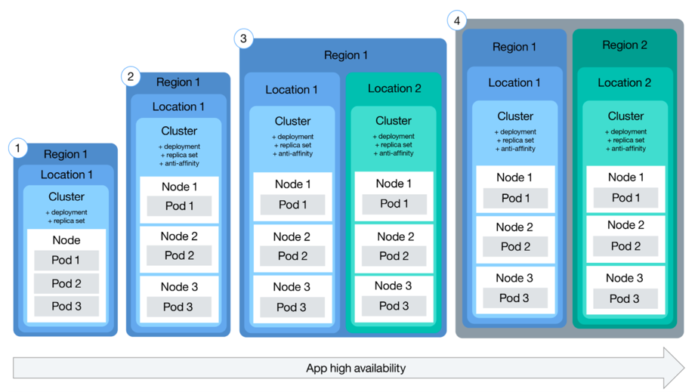
Cluster and Application Resiliency – HA Patterns

Slide 12
Demo- Cluster and Persistent storage

Slide 13
Question/discussion ?????
Thank you

